Slide 1
Bihar Ride: Building a Hyper-Local Transportation App for Bihar
The transportation market in Bihar is experiencing explosive growth, presenting a unique opportunity for entrepreneurs who understand the state's distinct cultural and infrastructural landscape. While national giants like Uber and Rapido operate with one-size-fits-all solutions, Bihar's transportation needs demand something fundamentally different—an app that speaks the local language, understands village addresses that don't exist on maps, and recognizes that attending a wedding might require booking ten vehicles at once for a baraat procession.
This presentation outlines a comprehensive strategy for building "Bihar Ride," a hyper-local ride-hailing platform designed specifically for Bihar's unique challenges and opportunities. We'll explore why cultural relevance beats scale, how to solve the "landmark-based address" problem that plagues rural India, and why integrating bus services with last-mile connectivity could be your competitive moat. Success here isn't about copying Silicon Valley playbooks—it's about building something that feels native to Bihar, from the language interface to the wedding rental packages.

Slide 2
CORE STRATEGY
Why Hyper-Local Beats Global in Bihar
The Local Advantage
Large aggregators like Uber and Rapido struggle in Bihar not because of technology limitations, but because their product design assumes urban infrastructure that simply doesn't exist here. Standard address systems break down in villages where directions are given as "behind the Durga Mandir" or "near the old Banyan tree." Wedding season creates demand patterns completely foreign to metro markets—customers need to book entire fleets for baraat processions, not individual point-to-point rides.
Bihar's transportation ecosystem operates on fundamentally different principles than metros like Mumbai or Bangalore. Success here requires deep cultural understanding, not just technological prowess.
Your competitive advantage lies in solving problems that national players consider edge cases but are actually mainstream needs in Bihar. When you design for "Party & Function Booking" , particulat rides from a local location to the specific area as a core feature rather than an afterthought, when your interface supports Bhojpuri and Maithili alongside Hindi and English, when your maps understand landmark-based navigation—you're not just another ride app, you're the only app that truly works for Bihar.

Slide 3

FEATURE #1
Party & Function Booking: The Wedding Economy
Bihar's social calendar revolves around functions—weddings, mundan ceremonies, thread ceremonies, and countless other occasions where transportation needs explode beyond individual rides. The traditional baraat alone might require coordinating 5-10 decorated vehicles for hours at a time. This isn't a niche use case; it's a massive market that existing apps completely ignore.
Rental & Fleet Module
Wedding Special Category
Driver Retention System
Move beyond point-to-point rides to time-based rentals. Users book vehicles for 4, 8, or 12-hour blocks, with the driver staying with the customer throughout the event. Pricing includes base fare plus per-kilometer and per-hour charges, making costs transparent and predictable.
Create a dedicated "Shaadi/Baraat" booking flow where users can reserve multiple vehicles simultaneously. Include options for vehicle decoration, procession coordination, and multi-stop itineraries. This feature alone could differentiate you from every competitor.
Drivers commit to staying with customers for the entire rental period, creating reliability that's crucial for time-sensitive events. Implement premium pricing for wedding bookings to incentivize driver participation and ensure availability during peak function seasons.

Slide 4


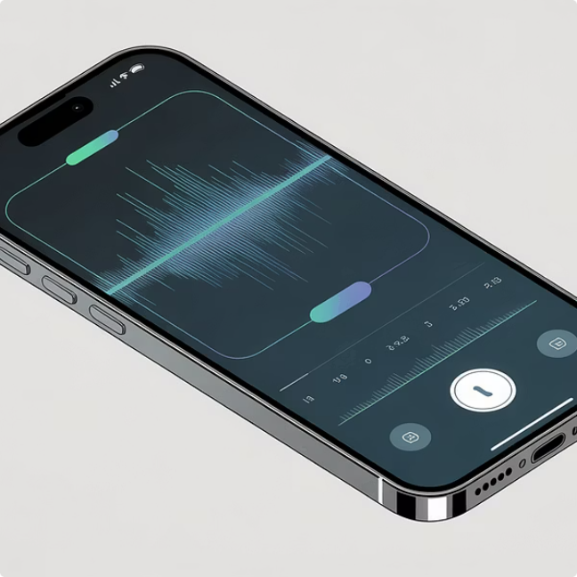
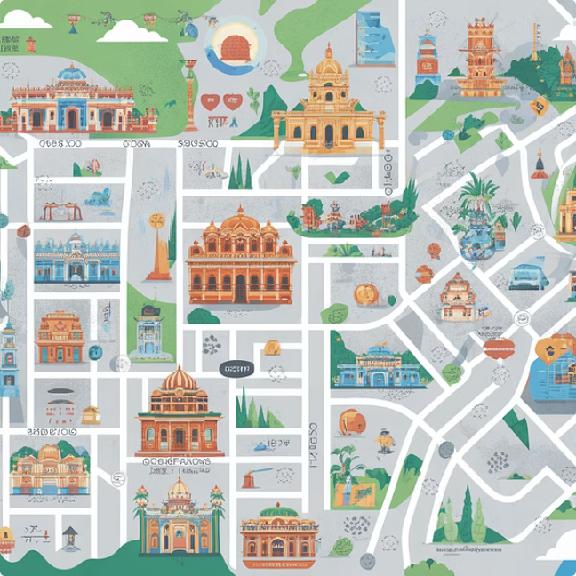
FEATURE #2
Smart Geolocation: Solving the Village Address Problem
Perhaps the most critical technical challenge in building a Bihar-focused ride app is handling locations that don't exist in any standard mapping system. In rural Bihar, formal addresses like "House 12, Street 4, Block B" simply don't exist. People navigate by landmarks, relationships, and local knowledge. A customer might describe their location as "the yellow school in Phulwari Sharif" or "the tea stall near where the old post office used to be." Standard GPS-based pickup fails completely in these scenarios.
WhatsApp Location Integration
Voice Note Booking
Landmark-Based Maps
Allow users to share their live location directly from WhatsApp into your app. This leverages familiar technology and provides drivers with the most accurate real-time positioning available, even in areas with poor address data.
Enable customers to record audio descriptions of their location in their preferred language—Hindi, Bhojpuri, or Maithili. Drivers hear the voice note and use local knowledge to navigate. This mirrors how people actually give directions in Bihar.
Integrate MapmyIndia (Mappls) APIs alongside Google Maps. Mappls often has superior rural coverage in India and better landmark data. Build a system that learns from successful pickups to improve landmark recognition over time.
This "Smart Pickup" system transforms the biggest weakness of existing ride apps into your core strength. While competitors struggle with village addresses, you'll be the app that actually works where people live.

Slide 5


FEATURE #3
Bus Integration: Becoming a Mobility Aggregator
The most transformative feature of Bihar Ride is bus integration—evolving from a simple ride-hailing app into a comprehensive Mobility as a Service (MaaS) platform. Bihar's intercity travel heavily relies on private bus operators like Gaurav Travels, Bihar State Transport, and dozens of smaller operators. By aggregating these services alongside your ride-hailing core, you solve the complete journey problem: not just getting from Point A to Point B, but also getting to the bus stand and from the destination bus stand to the final location.
Book Bus
Book Pickup
Travel to Stand
Board Bus
Select route, date, and seats
Schedule ride to bus stand
Driver takes you to departure point
Confirm ticket and board bus
This integrated approach solves real pain points. Users no longer juggle multiple apps or worry about missing their bus because their auto got delayed. You create a single, trusted platform for intercity travel—and capture revenue at multiple touchpoints.
The "My Favourite Bus" feature creates sticky user behavior. Customers can save preferred bus operators based on reliability, comfort, or pricing. When they search for routes—say, Patna to Muzaffarpur—the app displays bus schedules from their saved operators first, along with estimated arrival times and real-time availability. The killer feature: seamless "Last Mile Ride" booking. With one tap, users book both their bus seat and a bike to take them from home to the bus stand, creating an integrated journey that no competitor offers.

Slide 6

FEATURE #4
Janata Ki Awaaz: Building Trust Through Community
In markets where brand trust takes years to build, creating a community feedback loop accelerates adoption and improvement. The "Sabha" (Assembly) or "Ray" (Opinion) section transforms your app from a transactional service into a community platform where users have genuine voice and influence. This isn't just a nice-to-have feature—it's a strategic differentiator that builds loyalty and provides invaluable market intelligence.
Community Polls
Issue Reporting
Bidirectional Rating System
Run location-specific polls asking questions like "Should we start auto services in Darbhanga?" or "What time should we increase driver availability in Kankarbagh?" This crowdsources your expansion strategy and makes users feel invested in the platform's growth.
Allow users to upload photos of bad roads, report areas with poor driver availability, or suggest new routes. This creates a powerful data feedback loop—you learn exactly where infrastructure challenges exist and where demand is unmet. Users become partners in improving service.
Move beyond simple driver ratings to rate app features themselves. Users can upvote requested features, report bugs, and suggest improvements. This transparent development approach builds trust and ensures you're building what customers actually want, not what you assume they need.
The Sabha section also serves a crucial cultural function—it mirrors the traditional panchayat system where community voices shape decisions. This cultural resonance makes your app feel authentically Bihari rather than like an imported tech solution.

Slide 7
OPERATIONS
Operational Strategy: Executing in Bihar's Market
Building the app represents perhaps 20% of the work—executing the business model in Bihar's complex regulatory and cultural environment is the real challenge. Success requires navigating legal compliance, building partnerships with bus operators, and marketing in ways that resonate with local audiences. Here's your operational playbook for launch and sustainable growth.
01
02
Legal & Compliance
Bus Partnership Strategy
Navigate Bihar's regulatory landscape proactively. Encourage drivers to obtain Commercial Registration (Yellow number plates) rather than using private vehicles (White plates)—operating private vehicles as taxis exists in a legal grey area that invites police trouble and fines. Apply for a state transport aggregator license through Bihar's transport department. Budget 2-3 months for license approval and maintain relationships with transport officials for smooth operations.
For bus integration, pursue a dual approach. First, integrate existing bus ticketing APIs from providers like RedBus or AbhiBus—they allow you to sell their inventory for a commission (typically 5-8%), giving you immediate scale without inventory risk. Simultaneously, visit major bus stands in Patna, Gaya, and Muzaffarpur to onboard private bus operators directly for better margins (15-20% commission). Offer them free listing initially to build inventory quickly.
03
04
Driver Acquisition
Marketing: The Bihari Touch
Focus on auto and bike drivers at major stands during off-peak hours (10 AM - 3 PM). Offer zero-commission rides for the first month, then graduated commission structure: 10% first three months, 15% months 4-6, 20% thereafter. Provide simple Hindi training on app usage. Partner with driver unions for credibility—getting union endorsement accelerates driver adoption significantly.
Internet advertising has limited effectiveness in Tier 2/3 Bihar cities. Instead, invest heavily in offline visibility: hoardings at major intersections and bus stands, wall paintings in high-traffic areas, vehicle stickers on existing autos (pay ₹500/month for prominent app stickers). Implement aggressive referral programs: "Refer a friend and get a free ride to the bus stand" or "Book your first wedding package and refer 5 families for 20% off." Leverage WhatsApp marketing in local community groups.

Slide 8
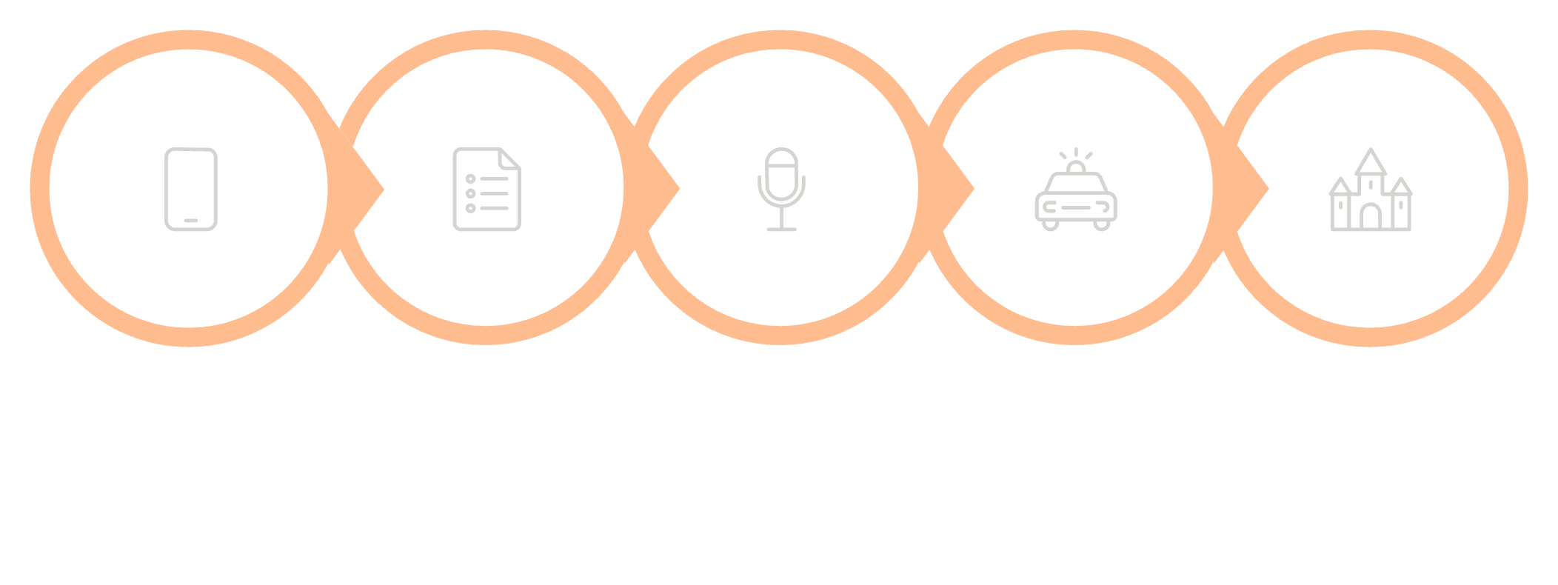










The Complete Bihar Ride User Journey
Understanding how all these features integrate into seamless user experiences is crucial for both product development and team training. Here's how Bihar Ride's unique feature set creates differentiated value across different use cases—from quick city rides to complex wedding logistics to intercity bus travel with last-mile connectivity.
Open App
Select Service
Book Ride
Driver Arrives
Give Feedback
Language Selection
User opens app and selects preferred language: Hindi, Bhojpuri, Maithili, or English. This choice persists across sessions and extends to voice navigation guidance.
Service Choice
Abhi Chalo: Immediate bike/auto ride. Function Booking: Reserve cars/bikes for 8 hours for wedding. Bus Ticket: Book seat on preferred operator plus bike ride to bus stand.
Smart Booking
User shares WhatsApp location or records voice note: "Main Phulwari Sharif mein peele school ke paas khada hoon" (I'm standing near yellow school in Phulwari Sharif).
Journey Completion
Driver receives voice note, navigates using combined Google Maps + MapmyIndia, picks up customer, completes ride. Payment via cash, UPI, or wallet.
Community Feedback
Post-ride, user rates driver and optionally visits Sabha section to write: "Please add more bikes in Kankarbagh area" or vote on expansion poll.

Slide 9
NEXT STEPS
From Concept to Launch: Your Action Plan
You now have a comprehensive blueprint for building Bihar Ride—a hyper-local transportation platform uniquely positioned to win in Bihar by solving problems that national competitors ignore. The path from concept to launch requires structured execution across product development, regulatory compliance, partnership building, and go-to-market strategy.
Immediate Next Steps
The Bihar Advantage
Create a Product Requirements Document (PRD): Translate this strategy into a detailed technical specification that developers can quote and build from. The PRD should outline every feature, user flow, API requirement, and integration point.
Get Development Quotes: Share the PRD with 3-5 development agencies (both Indian and international). Budget ₹15-25 lakhs for MVP development with all core features. Prioritize agencies with ride-hailing experience.
Secure Seed Funding: Approach angel investors or micro-VCs focused on Tier 2/3 India. Bihar's transportation market size and your cultural differentiation make a compelling pitch. Target ₹50 lakhs seed round.
Build Initial Partnerships: While app is in development, visit bus operators and driver unions in Patna. Get 2-3 committed bus partners and 25-50 driver commitments before launch.
Start Legal Process: Apply for aggregator license immediately—bureaucratic processes take time. Consult with a local Bihar lawyer familiar with transport regulations.
Bihar's GDP is growing at 10%+ annually—faster than most Indian states. The transportation market is exploding but underserved. Your hyper-local approach isn't just culturally appropriate; it's a legitimate competitive moat against national players.
Success here isn't about replicating Uber's playbook—it's about building something authentically Bihari that solves real problems in culturally resonant ways. From voice-note pickup locations to wedding fleet bookings to the Sabha community section, every feature says: "We understand Bihar."
Are you ready to build Bihar Ride? The market opportunity is massive, the competitive positioning is strong, and the technical roadmap is clear. The question isn't whether this can work—it's whether you'll execute fast enough to capture this rapidly growing market before someone else does.

